Slide 1
Plate Detection
Pol Gràcia, Daniel Navarro & Miguel Esteban

Slide 2
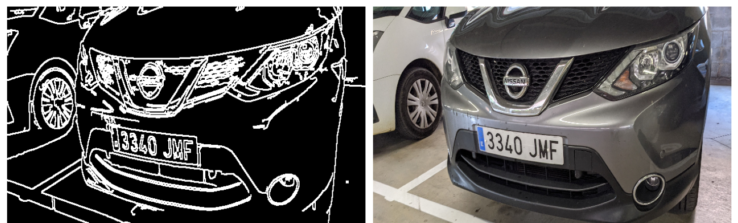


Plate locator

Slide 3
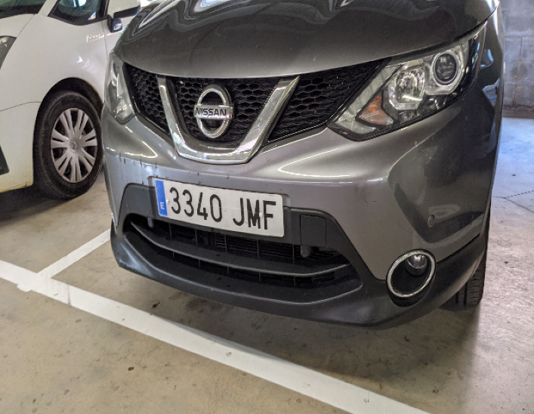
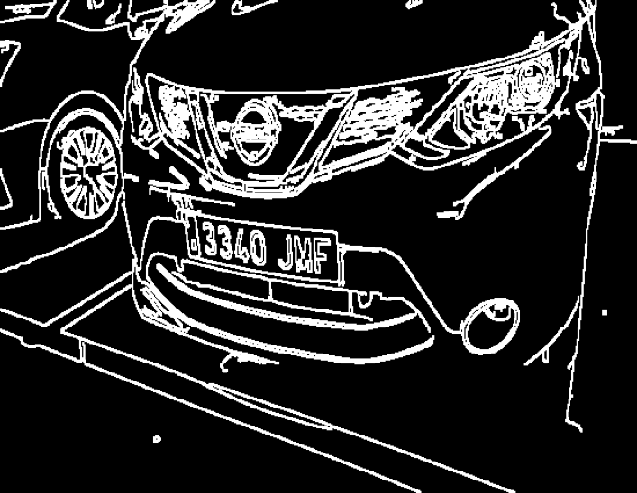
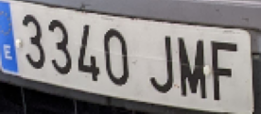

Our approach
Noise reduction & edge preservation (bilateral filter)
Gray scaling
Canny edge detection (binarization)
Dilation
Sorted by x axis contour detection
Only 12 biggest areas are kept

Slide 4
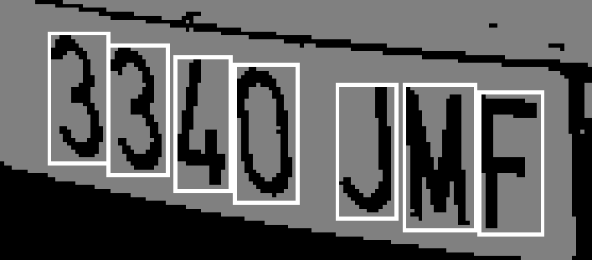
Number detection

Slide 5
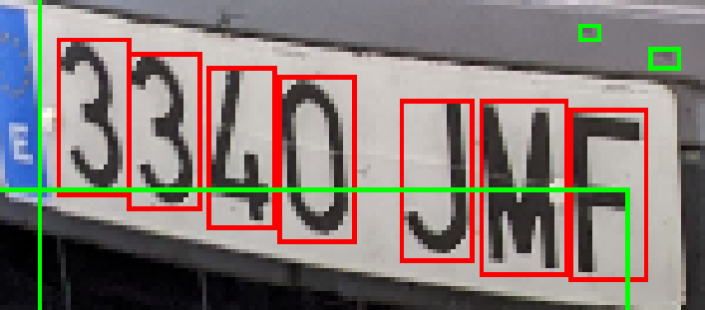
Our approach
Inverse binary threshold
Connected components
$$k=4$$
Connected components
𝑘=4
Check candidate
Resize to $60 × 30$ pixels
Resize to 60 × 30 pixels

Slide 6

Training approaches
Labeled images
Data augmentation

Slide 7
DataSets
SVM, KNN & Decision Tree
Using the provided images, a labeled dataset is created
Fewer samples archive highs accuracies
Deep Learning
We adquired the base font mandated by the European Commision legislation. DIN 1451
This font, along with the labeled dataset, is used to create a new dataset using Data Augmentation
Huge ammount of samples are needed for Deep Learning models to classify correctly

Slide 8
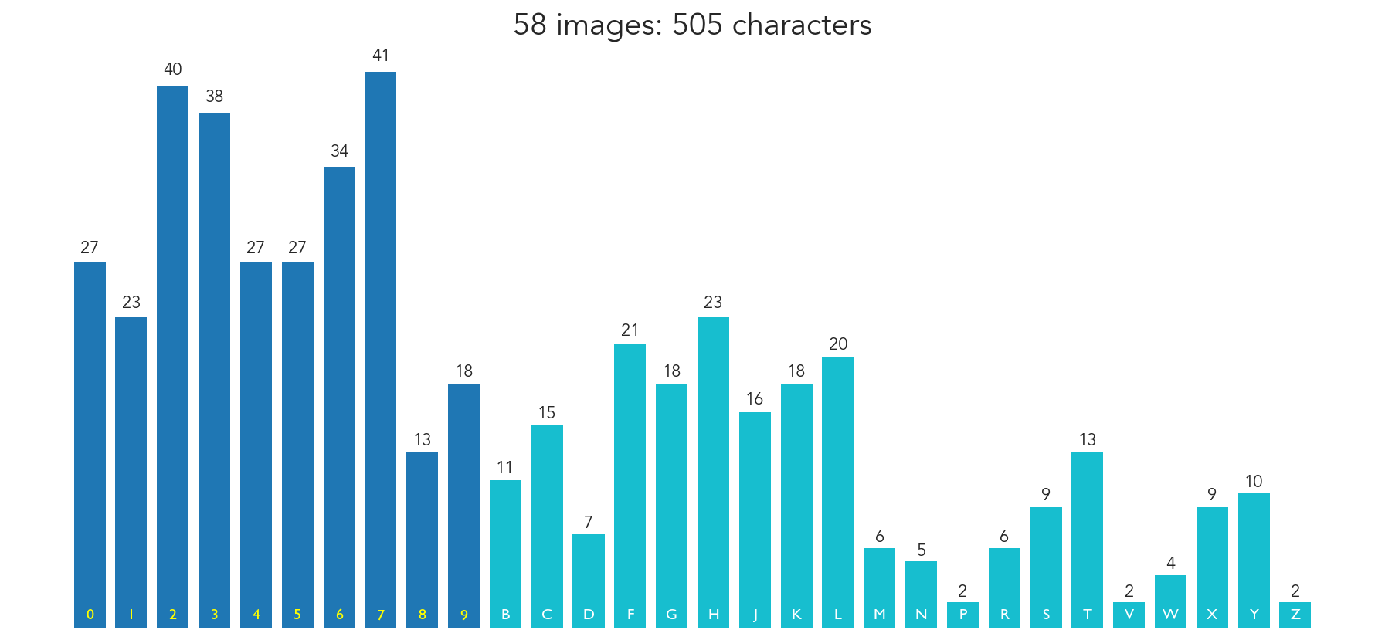

Slide 9
Model parameters
SVC
KNN,
Decision Tree

Slide 10

Machine Learning
SVC
Kernel type
C
KNN
Algorithm
Neighbours
Decision Tree
Criterion
Features
Splitter

Slide 11
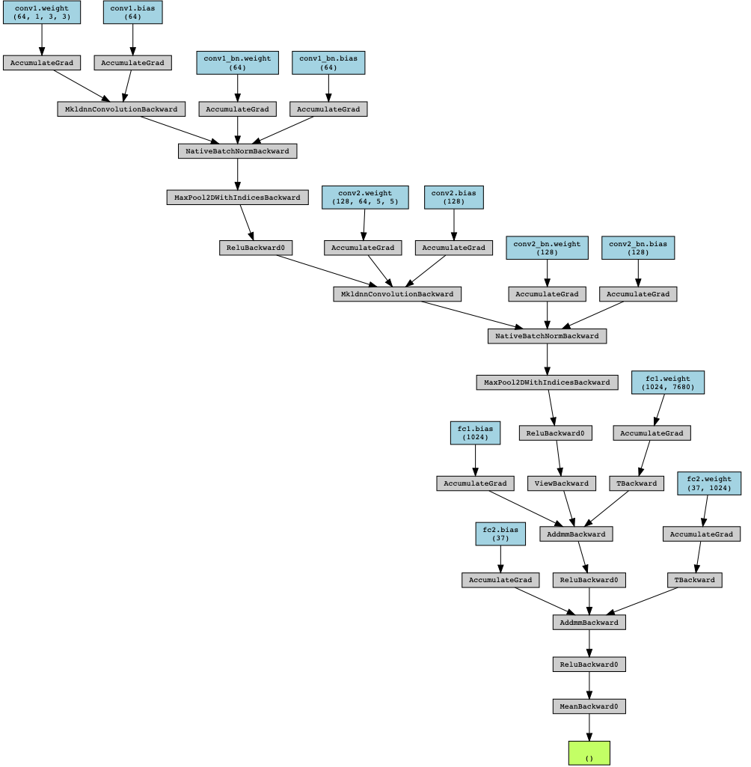
Deep Learning

Slide 12
Model comparation
SVC, KNN, Decision Tree & Deep Learning

Slide 13
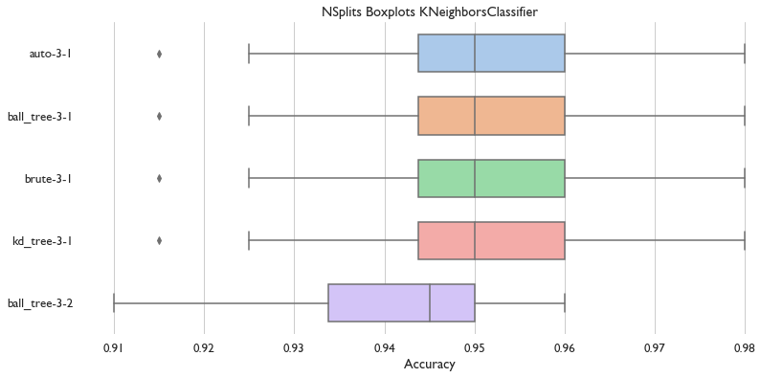
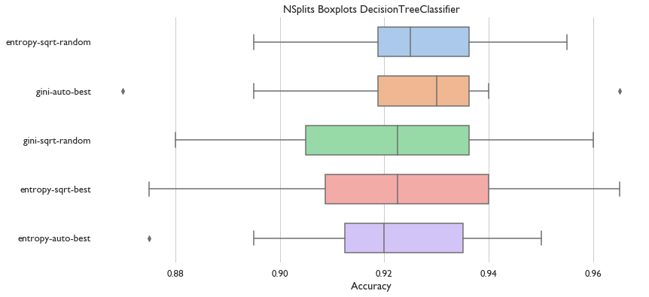
Decision Tree & KNN
Dataset accuracy: 0.97256
Dataset accuracy: 0.50623

Slide 14
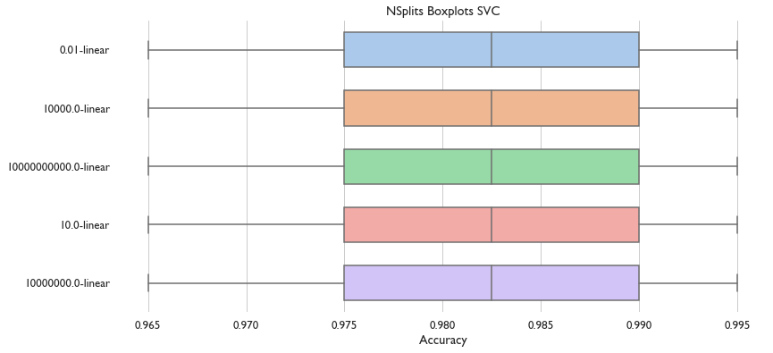
SVC
Dataset accuracy: 0.9750

Slide 15
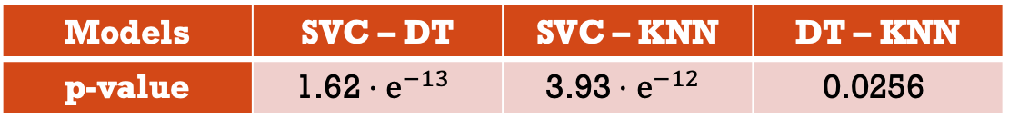
ANOVA
Models | SVC – DT | SVC – KNN | DT – KNN
p-value | $$\text{1.62}⋅e^{−13}$$ | $$\text{3.93}⋅e^{−12}$$ | $$\text{0.0256}$$
As can be seen on the table, all models are different. Subsequently we select SVC as it has the higher mean accuracy
Model | SVC | Decision Tree | KNN
Accuracy | 0.9750 | 0.50623 | 0.97256

Slide 16

Demo

